Slide 1
APB PROTOCOL
ADVANCED PERIPHERAL BUS PROTOCOL

Slide 2
INDEX
INTRODUCTION OF AMBA
ABOUT AMBA BUS ARCHIETICTURE
INTRODUCTION OF APB PROTOCOL
SIGNAL DESCRIPTIONS
MASTER- SLAVE COMMUNICATION
STATE MACHINE
TIMING DIAGRAMS

Slide 3
INTRODUCTION OF AMBA
AMBA(Advanced micro control Bus Architecture) is introduced by ARM(Advanced RISC Machine) in 1996.
AMBA is a family for all protocols. Like as ASB,APB,AHB, AXI….,etc.
AMBA is a set of interconnect protocols.

Slide 4
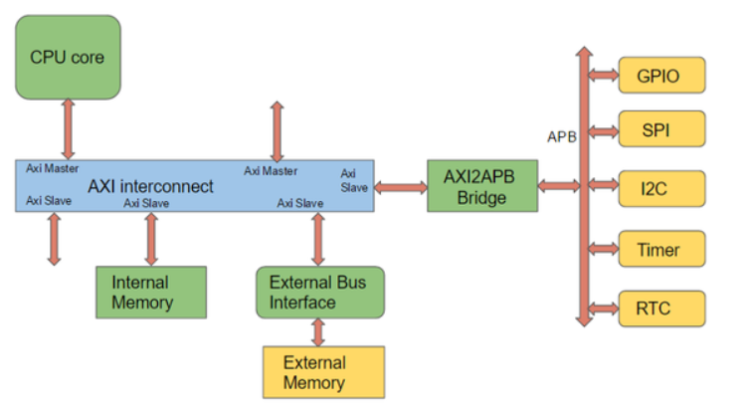
AMBA BUS ARCHIETICTURE

Slide 5
APB PROTOCOL
APB protocol is a part of AMBA family. APB protocol is low-cost interface that optimized for minimal power consumption.
It is reduced interface complexity. It is not pipelined and is a simple.
Every transfer takes at least two cycles to complete.
APB Bridge connected from AHB.
All the singles transitions are only related to the raising edge of the clock to enable the integration of APB peripherals.

Slide 6
Signal Descriptions
PCLK : All APB signals are timed against the rising edge of PCLK.
PRESETn : PRESETn is the reset signal and is Active-LOW.
  PRESETn is normally connected directly to the system bus reset signal.
PADDR : PADDR is the APB address bus. PADDR can be up to 32 bits wide.
PSELx : The APB bridge unit generates this signal to each peripheral bus slave. It indicates that the slave is selected and that a data transfer is required. There is each PSELx signal for each slave.
PENABLE: PENABLE indicates the second and subsequent cycles of an APB transfer.
PWRITE: The signal indicates an APB write access when HIGH and an APB read access when LOW.
PWDATA: The PWDATA write data bus is driven by the APB bridge when PWRITE is HIGH.

Slide 7
SIGNAL DESCRIPTIONS..
PRDATA : The PRDATA read data bus is driven by the APB peripheral bus slave when PWRITE is LOW
PREADY: The APB peripheral slave uses this signal to extend an APB transfer.
PSLVERR: This signal indicates transfer failure. PSLVERR is HIGH when PSELx, PENABLE, PREADY are HIGH else becomes LOW.

Slide 8
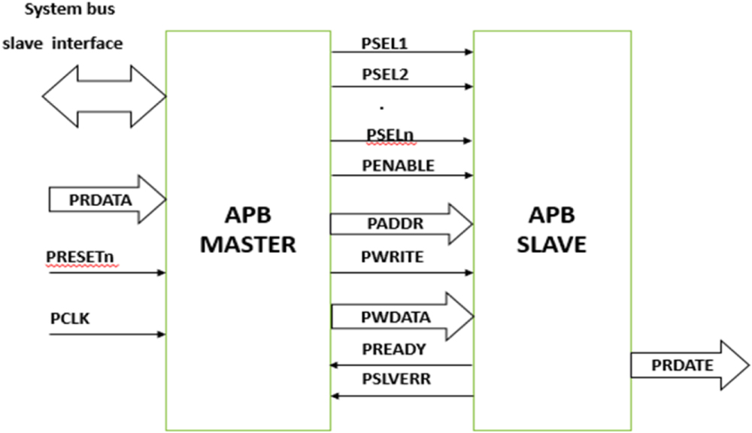
MASTER- SLAVE COMMUNICATION:

Slide 9
STATE MACHINE:
IDLE
Default APB State
SETUP
When Transfer required
PSELx=1 asserted
Only one cycle
ACCESS
PENABLE is asserted, where
Address, write, select, and write data
remain same.
Stay if PREADY=0,
Else go to IDLE if PREADY=1
No data transfer.
go to SETUP is PREADY=1, when more
data pending.
Idle
PSELx=0
PENABLE=0
No transfer
transfer
SETUP
PSELx=1
PENABLE=0
PREADY=1
When no data transfer
PREADY=1
When data transfer
transfer
PREADY=0
ACCESS
PSELx=1
PENABLE=1

Slide 10
WRITE TRANSFERS:
This section describes the following types of write transfer:
• With no wait states
• With wait states
All signals shown in this section are sampled at the rising edge of PCLK.
With no wait states:
The Setup phase of the write transfer occurs at T1 in Figure.
The select signal, PSELx, is asserted, which means that PADDR, PWRITE and PWDATA must be valid.
The Access phase of the write transfer is shown at T2 in Figure. where PENABLE is asserted.
PREADY is asserted by the Completer at the rising edge of PCLK to indicate that the write data will be accepted at T3. PADDR, PWDATA, and any other control signals, must be stable until the transfer completes. At the end of the transfer, PENABLE is deasserted. PSELx is also deasserted, unless there is another transfer to the same peripheral.

Slide 11
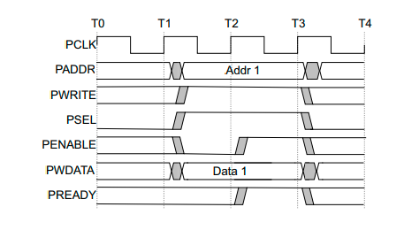
Figure: Write transfer no waits states.

Slide 12
With wait state:
During an Access phase, when PENABLE is HIGH, the APB peripheral extends the transfer by driving PREADY LOW. The following signals remain unchanged while PREADY remains LOW:
• Address signal, PADDR
• Direction signal, PWRITE
• Select signal, PSELx
• Enable signal, PENABLE
• Write data signal, PWDATA
• PREADY can take any value when PENABLE is LOW. This ensures that peripherals that have a fixed two cycle access can tie PREADY HIGH.

Slide 13
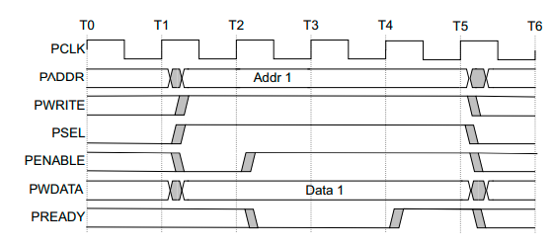
Figure: With wait state transfer

Slide 14
READ TRANSFER:
Two types of read transfer are described in this section:
• With no wait states
• With wait states
All signals shown in this section are sampled at the rising edge of PCLK.
With no wait states:
The timing of the address, PADDR, write, PWRITE, select, PSELx, and enable, PENABLE, signals are the same as described in Write transfers on page.
The Completer must provide the data before the end of the read transfer.

Slide 15
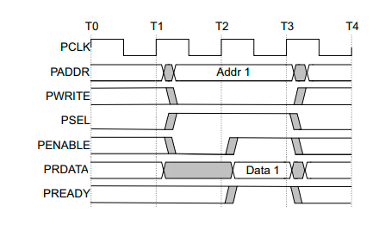
Read transfer with no wait states

Slide 16
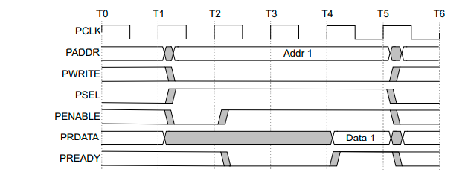
With wait states:
The transfer is extended if PREADY is driven LOW during an Access phase. The following signals remain unchanged while PREADY remains LOW:
• Address signal, PADDR
• Direction signal, PWRITE
• Select signal, PSEL
• Enable signal, PENABLE
Read transfer with wait states
Figure: Shows that two cycles are added using PREADY. However, any number of additional cycles can be added, from zero upwards.

Slide 17
Error response:
PSLVERR can be used to indicate an error condition on an APB transfer. Error conditions can occur on both read and write transactions.
PSLVERR is only considered valid during the last cycle of an APB transfer, when PSEL, PENABLE, and PREADY are all HIGH.
It is recommended, but not required, that PSLVERR is driven LOW when PSEL, PENABLE, or PREADY are LOW.
Transactions that receive an error might or might not have changed the state of the peripheral. This is peripheral-specific and either state is acceptable.
When a write transaction receives an error, this does not mean that the register within the peripheral has not been updated.
Read transactions that receive an error can return invalid data. There is no requirement for the peripheral to drive the data bus to all 0s for a read error.
A Requester which receives an error response to a read transfer might still use the data.
A Completer cannot rely on the error response to prevent the reading of a value on PRDATA.
Completers are not required to support PSLVERR. Where a Peripheral does not include PSLVERR, the appropriate input to the Requester is tied LOW.

Slide 18
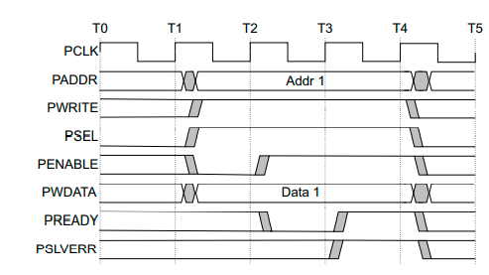
Write transfer error:
An example of a failing write transfer that completes with an error.
Example of failing write transfer

Slide 19
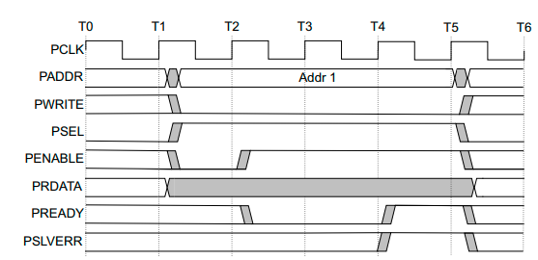
Read transfer error:
A read transfer can also complete with an error response, indicating that there is no valid read data available.
Example failing read transfer

Slide 20
UVM TEST BENCH ARCHITECTURE
apb_top
apb_test
apb_env
apb_subscriber
apb_scoreboard
BFM
apb_seq_item
apb_seqr
apb_mon
apb_assertions
apb_sequence
apb_driver
apb_interface
apb_rtl

Slide 21
Thank you !!!

